Slide 1
Ransomware Defense: Building a Bulletproof Backup Strategy
Mr Sunil Kumar

Slide 2

About me
Freelance corporate trainer
Tech enthusiast
Tech community builder
YouTube:https://www.youtube.com/@sunilkumarOnCloud
Medium blog: https://medium.com/@suniel.vns
Topmate: https://topmate.io/sunilkumar7
Twitter: @techwithsunil
Toastmasters International member
Runner
https://www.linkedin.com/in/sunilkumardigi/

Slide 3
Agenda
What is ransomware?
Why attacks succeed?
What is the cost to business?
How to protect?
Azure backup
Azure backup demo
Validate backup
What to do before an attack
What to do during an attack
Post attack
References
Q&A

Slide 4
Know your audience quiz!
https://quizizz.com/admin/quiz/6262702594bac3001d85bf66

Slide 5
Ransomware
Ransomware is a type of malware* that infects a computer and restricts a user's access to the infected system or specific files in order to extort them for money.
*short for malicious software, is any software intentionally designed to harm, exploit, or otherwise compromise devices, networks, or data.

Slide 6
Ransomware cont..
After the target system is compromised, it typically locks out most interaction
displays an on-screen alert, typically stating that the system is locked or that all of their files have been encrypted.
Example: WannaCry Ransomware- May 2017

Slide 7
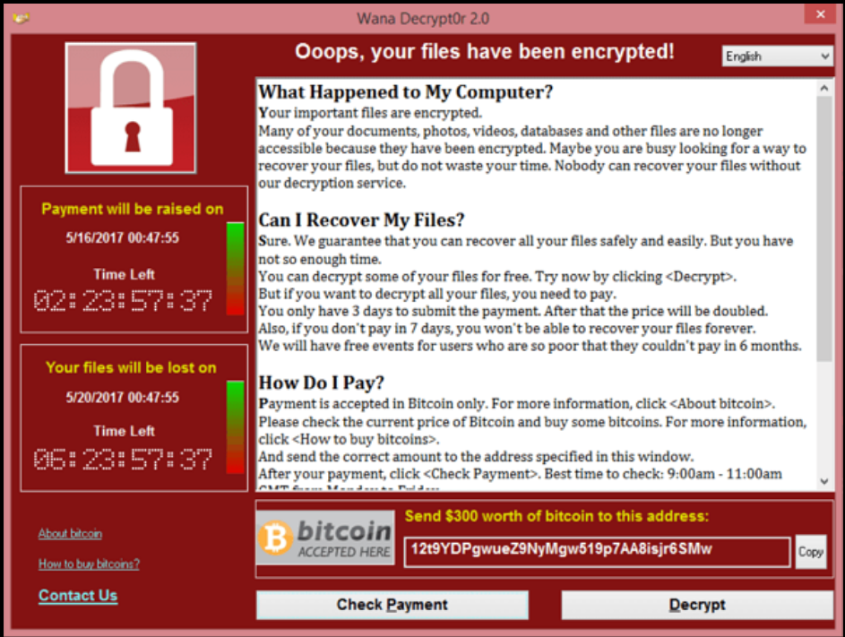
On-screen alert- WannaCry Ransomware
Source: Wikipedia

Slide 8
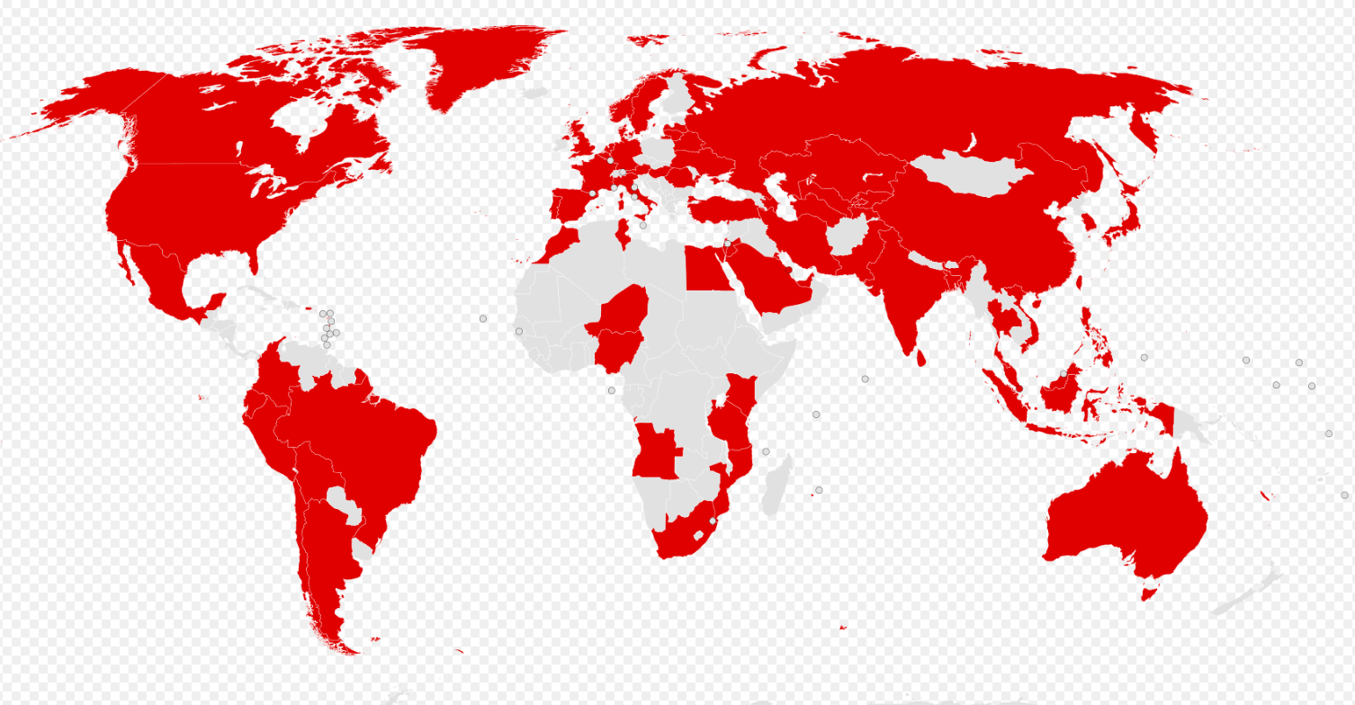
Map of the countries initially affected by WannaCry Ransomware
Source: Wikipedia

Slide 9
Why attacks succeed
The attack surface is increased as more businesses offer more services through digital outlets.
There's a considerable ease of obtaining off-the-shelf malware, Ransomware-as-a-Service (RaaS)
The option to use cryptocurrency for blackmail payments opens new avenues for exploit
Expansion of computers and their usage in different workplaces each of which is a potential access point for malware, resulting in potential attack surface
Prevalence of old, outdated infrastructure systems and software

Slide 10
Why attacks succeed cont..
Poor patch-management regimens
Outdated or old operating systems that are close to or have gone beyond end-of-support dates
Lack of resources to modernize the IT footprint
Knowledge gap
Lack of skilled staff and key personnel overdependency
Poor security architecture

Slide 11
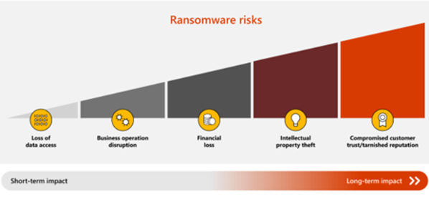
What is the typical cost to a business?
Loss of data access
Business operation disruption
Financial loss
Intellectual property theft
Compromised customer trust and a tarnished reputation

Slide 12
How can you protect yourself?
The best way to prevent falling victim to ransomware is to implement preventive measures
Protect your organization from every step that attackers take to infiltrate your systems.
CSP’s have invested in native security capabilities that make them resilient against ransomware attacks and helps organizations defeat ransomware attack techniques.

Slide 13
How can you protect yourself? Cont..
One of the most important steps you can take to protect your data and avoid paying a ransom is to have a reliable backup and restore plan for your business-critical information.

Slide 14
Azure Backup
Azure Backup provides security to your backup environment, both when your data is in transit and at rest.
With Azure Backup, you can back up:
On-premises files, folders, and system state
Entire Windows/Linux VMs
Azure Managed Disks
Azure file shares to a storage account
SQL Server databases running on Azure VMs

Slide 15
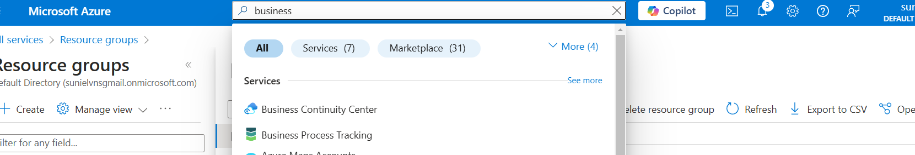
Azure Backup demo: Business Continuity Center

Slide 16
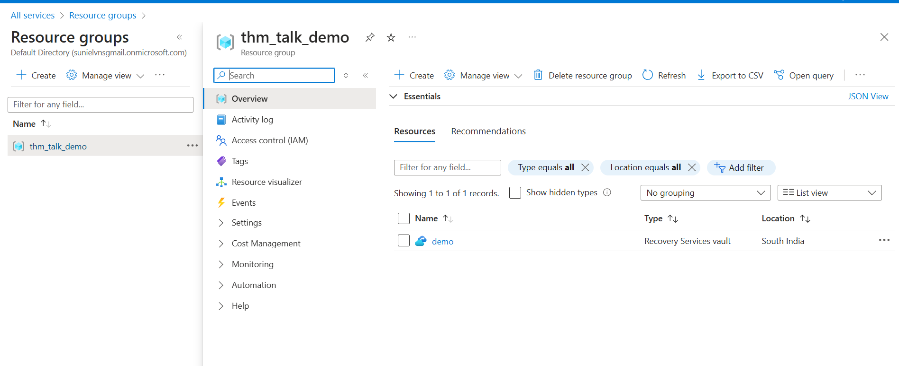

Azure Backup demo:-Recover Service vault

Slide 17
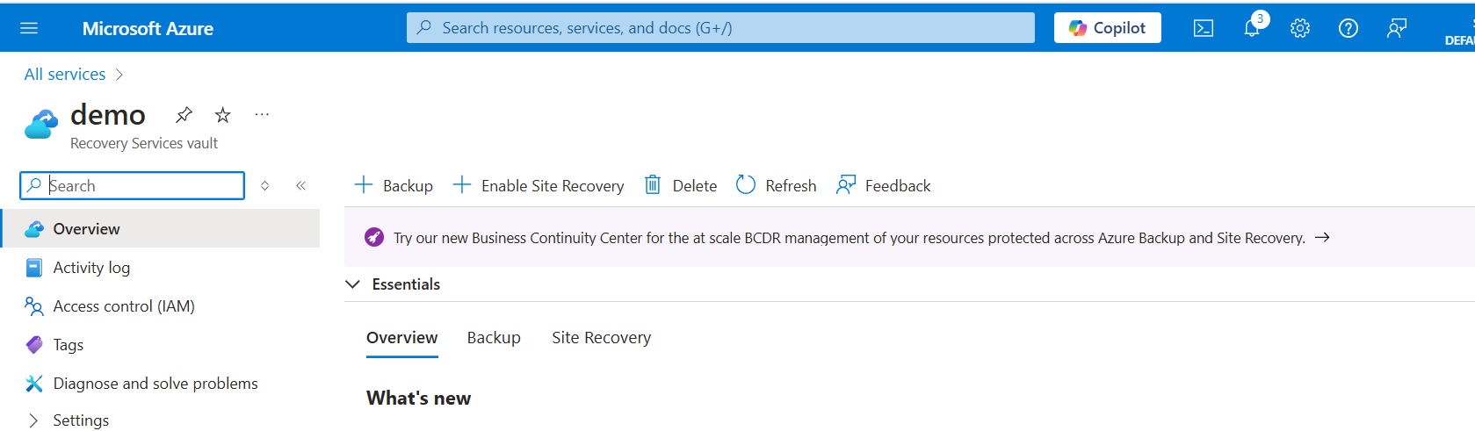
Azure Backup demo: Backup goal

Slide 18
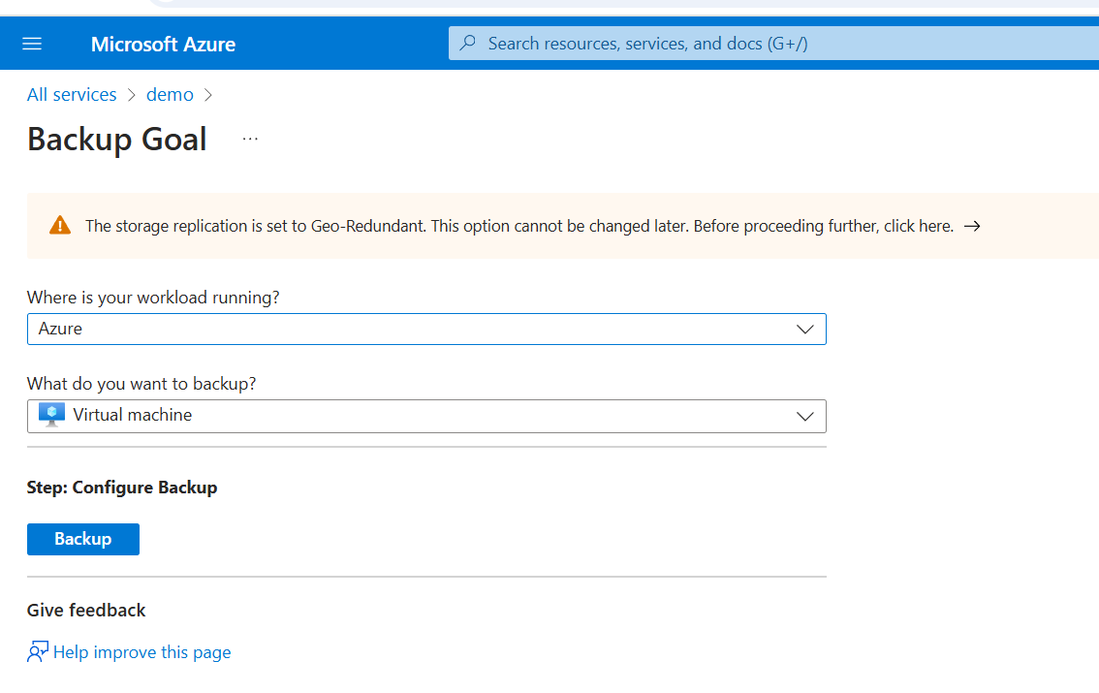
Azure Backup demo: Backup Goal

Slide 19
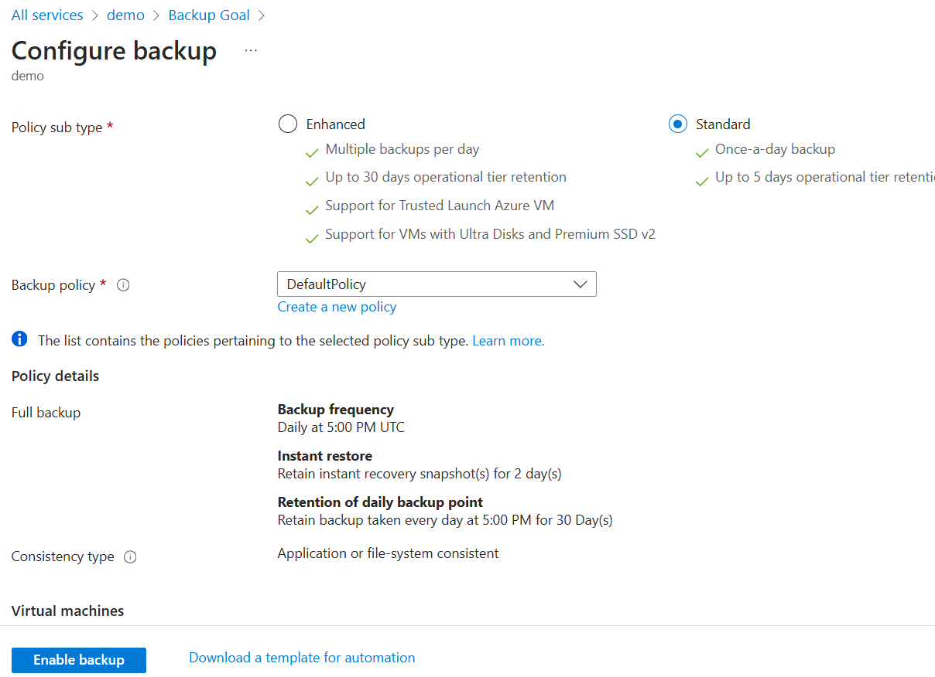
Azure Backup demo: configure Backup

Slide 20
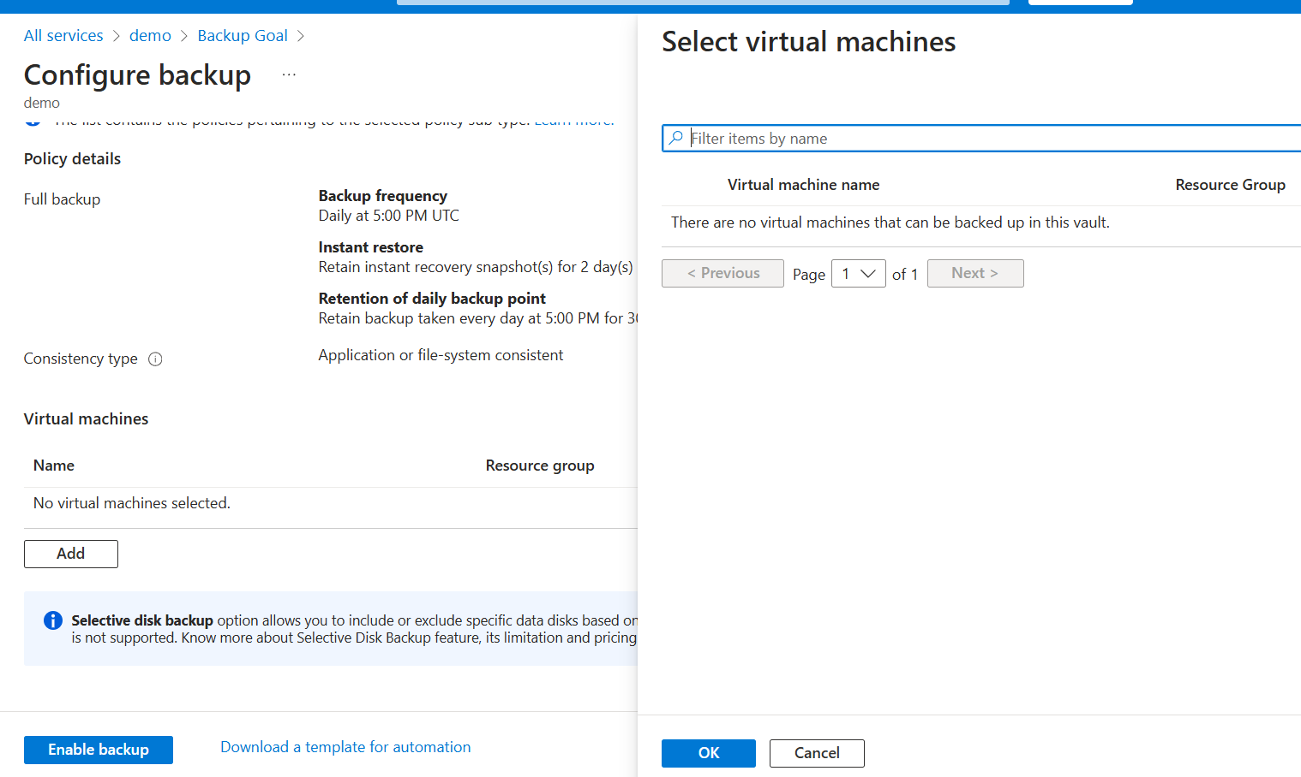
Azure Backup demo: Add Virtual Machine

Slide 21
Validate backups
Validate that your backup is good as your backup is created and before you restore.
We recommend that you use a Recovery Services vault, which is a storage entity in Azure that houses data.

Slide 22
What to do before an attack?
Determine what is most important to you
Identity systems – required for users to access any systems such as Active Directory, Microsoft Entra Connect, AD domain controllers
Human life – any system that supports human life or could put it at risk such as medical or life support systems, safety systems large machinery, chemical/biological systems, production of food or personal products, and others
Financial systems – systems that process monetary transactions and keep the business operating, such as payment systems and related databases, financial system for quarterly reporting

Slide 23
What to do before an attack? cont..
Product or service enablement – any systems that are required to provide the business services or produce/deliver physical products that your customers pay you for, factory control systems, product delivery/dispatch systems.
Security (minimum) – Prioritize the security systems required to monitor for attacks and provide minimum security services. This should be focused on ensuring that the current attacks (or easy opportunistic ones) aren't immediately able to gain (or regain) access to your restored systems

Slide 24
Steps to take before an attack
Identify the important systems that you need to bring back online first and immediately begin performing regular backups of those systems. | To get back up and running as quickly as possible after an attack, determine today what is most important to you.
Migrate your organization to the cloud. Consider purchasing a Microsoft Unified Support plan or working with a Microsoft partner to help support your move to the cloud. | Reduce your on-premises exposure by moving data to cloud services with automatic backup and self-service rollback. Microsoft Azure has a robust set of tools to help you back up your business-critical systems and restore your backups faster.
Best practices before an attack

Slide 25
What to do during an attack
Early in the attack, engage third-party support, particularly support from threat intelligence providers, anti-malware solution providers and from the malware analysis provider. | These contacts may be useful if the given ransomware variant has a known weakness or decryption tools are available. The Microsoft Incident Response team can help protect you from attacks.
Contact your local or federal law enforcement agencies. | If you're in the United States, contact the FBI to report a ransomware breach using the IC3 Complaint Referral Form.

Slide 26
Post attack
After a ransomware attack, take the following steps to improve your backup and restore plans as well as your security posture:
Identify lessons learned where the process didn't work well
Perform root cause analysis (RCA) on the biggest challenges
Investigate and remediate the original breach (engage the Microsoft Incident Response team to help)
Update your backup and restore strategy based on lessons learned and opportunities — prioritizing based on highest impact and quickest implementation steps first

Slide 27
References
https://learn.microsoft.com/en-us/azure/security/fundamentals/backup-plan-to-protect-against-ransomware
Wikipedia
Azure portal

Slide 28
Q&A

